Slide 1
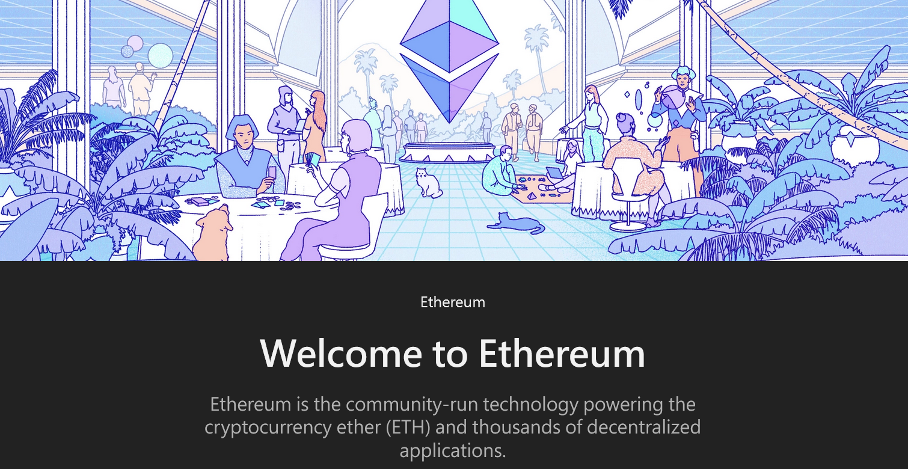
11. Ethereum 2.0
Ethereum Development Documentation

Slide 2
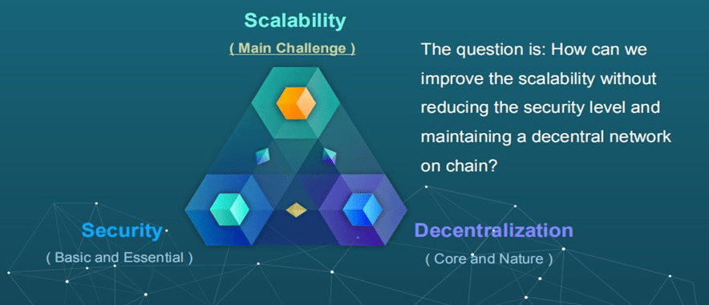
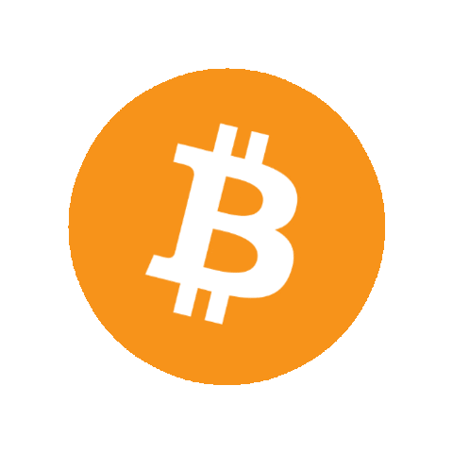
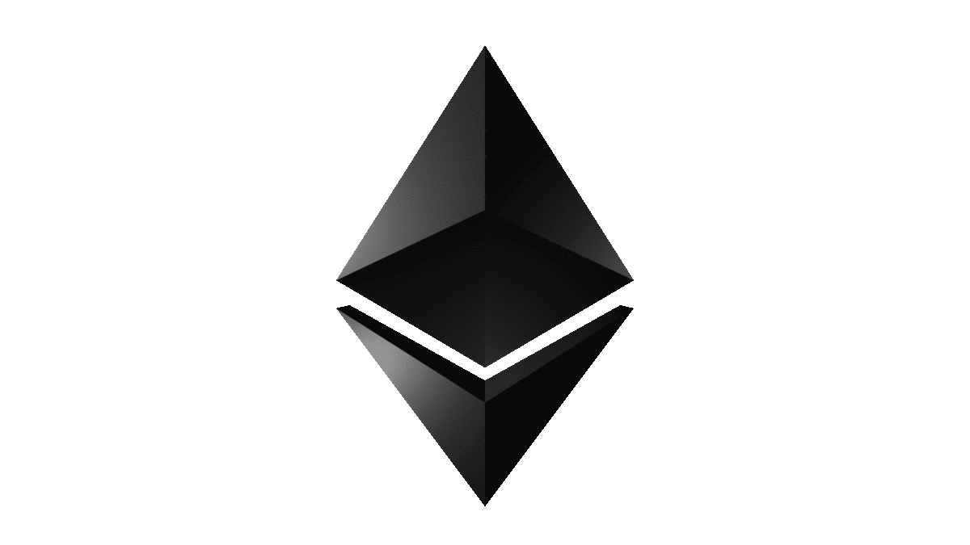
Blockchain Trilemma
Widely held belief that decentralized networks can only provide two of three benefits at any given time.

Slide 3
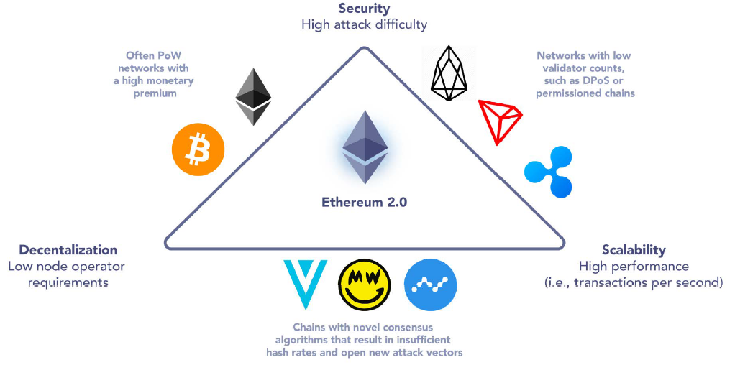
Mapping Blockchains According to the Trilemma
https://www.loganjastremski.com/p/ethereum

Slide 4
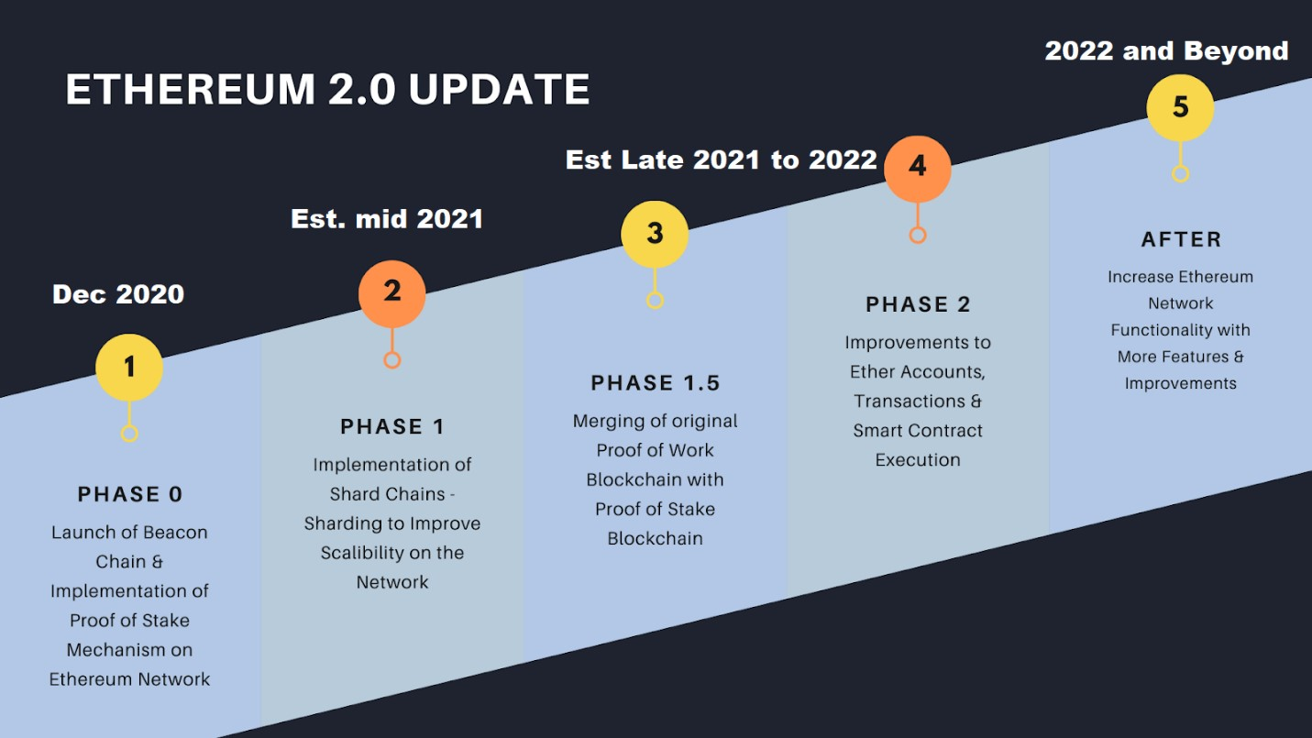
The Roadmap (Plan) to Serenity
2022.9.15
✓

Slide 5
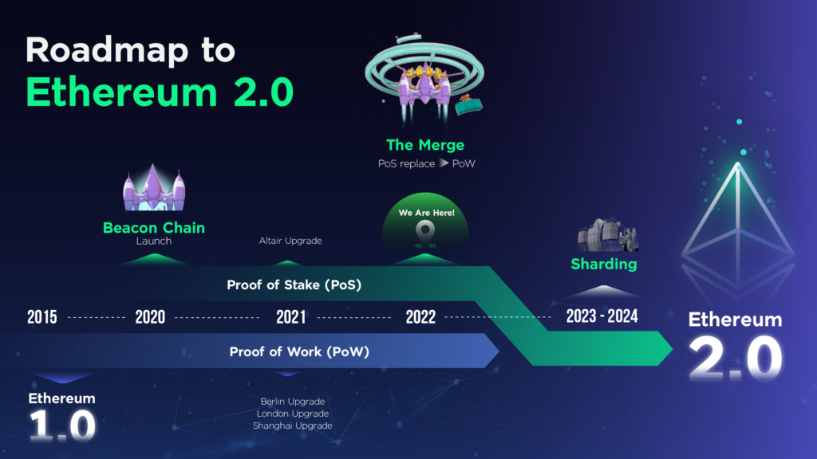
https://www.indexuniverse.eu/ethereum/ethereum-roadmap/
(Phase 0)
(Phase 1)
(Phase 2)

Slide 6
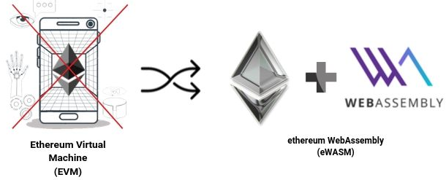
Main Features of Serenity
1
Switch from a Proof-of-Work (PoW)-based chain to a Proof-of-Stake (PoS)-based chain (The Merge, Completed on Sept. 15, 2022)
Sharding, which introduces the concept of shard chains and allows increased transaction throughput and immediate finality.
Sidechains will be used to enhance privacy, permissions, and governance. (Ethereum Scaling)
eWASM, an improved version of the Ethereum Virtual Machine (EVM).
2
3
4

Slide 7
Beacon Chain
https://ethereum.org/en/roadmap/beacon-chain/
The Beacon Chain was the name of the original PoS blockchain that was launched in 2020. It was created to ensure the PoS consensus logic was sound and sustainable before enabling it on Ethereum Mainnet. Therefore, it ran alongside the original PoW Ethereum.
Switching off PoW and switching on PoS on Ethereum required instructing the Beacon Chain to accept transactions from the original Ethereum chain, bundle them into blocks and then organize them into a blockchain using a PoS based consensus mechanism.
At the same moment, the original Ethereum clients turned off their mining, block propagation and consensus logic, handing that all over to the Beacon Chain. This event was known as The Merge. Once The Merge happened, there were no longer two blockchains; there was just one PoS Ethereum chain.

Slide 8
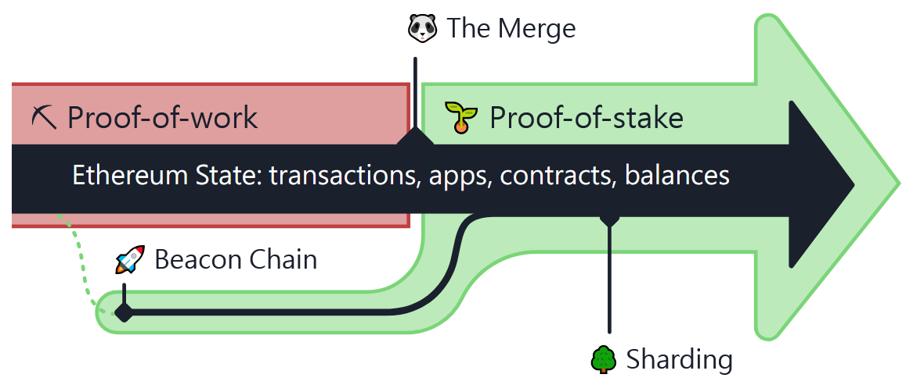
The Merge (1/6)
https://ethereum.org/en/roadmap/merge/
The Merge was the joining of the original execution layer of Ethereum (the Mainnet) with its new PoS consensus layer, the Beacon Chain.
This completed Ethereum's transition to PoS consensus, officially deprecating PoW and reducing energy consumption by ~99.95%.
No history was lost in The Merge.

Slide 9
The Merge (2/6)
The Merge and the Beacon Chain
The Merge represents the formal adoption of the Beacon Chain as the new consensus layer to the original Mainnet execution layer. Since The Merge, validators are assigned to secure Ethereum Mainnet, and mining on PoW is no longer a valid means of block production.
Blocks are instead proposed by validating nodes that have staked ETH in return for the right to participate in consensus. These upgrades set the stage for future scalability upgrades, including sharding.
The Merge and the Shanghai upgrade (on March 12, 2023)
The Merge upgrade did not include certain anticipated features such as the ability to withdraw staked ETH. This functionality was enabled separately with the Shanghai/Capella upgrade.

Slide 10
The Merge (3/6)
The Merge and Sharding
Originally, the plan was to work on sharding before The Merge to address scalability. However, with the boom of layer 2 scaling solutions, the priority shifted to swapping proof-of-work to proof-of-stake first.
Plans for sharding are rapidly evolving, but given the rise and success of layer 2 technologies to scale transaction execution, sharding plans have shifted to finding the most optimal way to distribute the burden of storing compressed calldata from rollup contracts, allowing for exponential growth in network capacity. (Please refer to “Proto-Danksharding”)

Slide 11
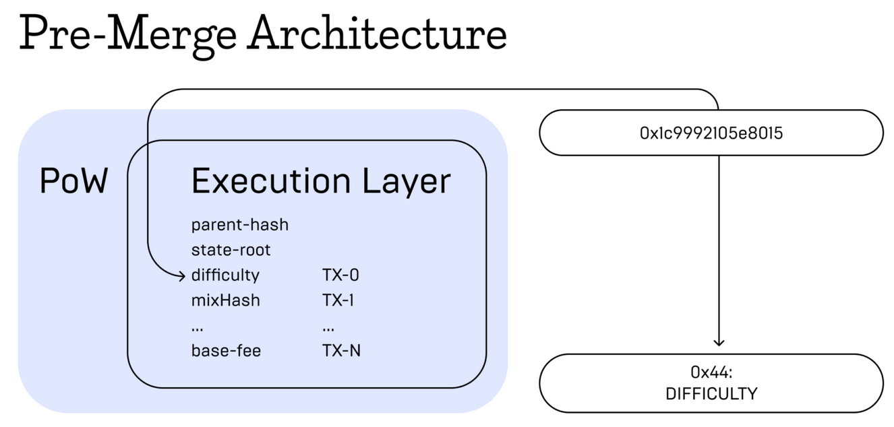
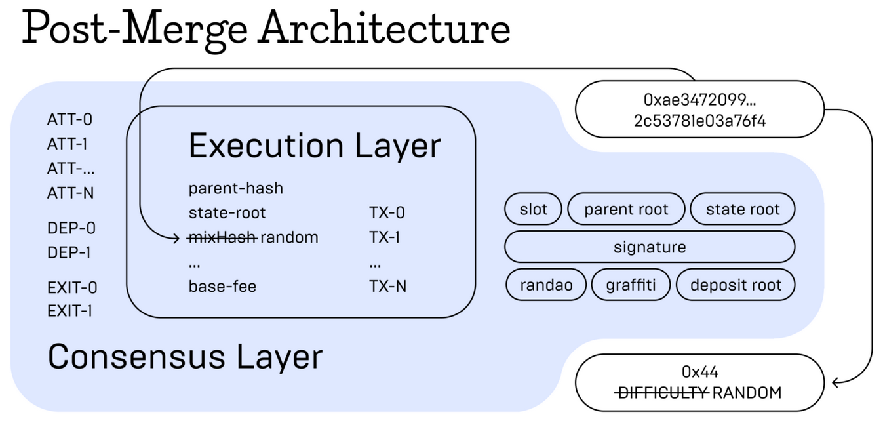
The Merge (4/6)
https://mercuryo.io/explore/article/merge-eth-2-0

Slide 12
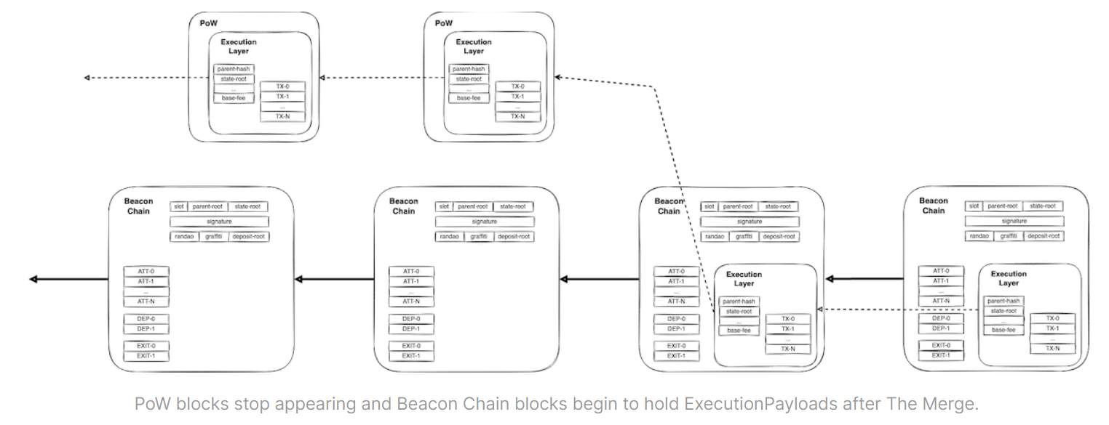
The Merge (5/6)
https://tim.mirror.xyz/sR23jU02we6zXRgsF_oTUkttL83S3vyn05vJWnnp-Lc

Slide 13
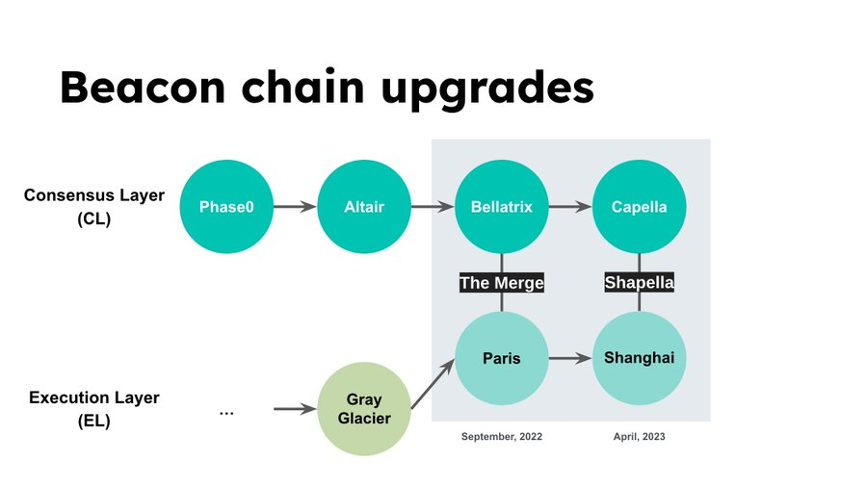
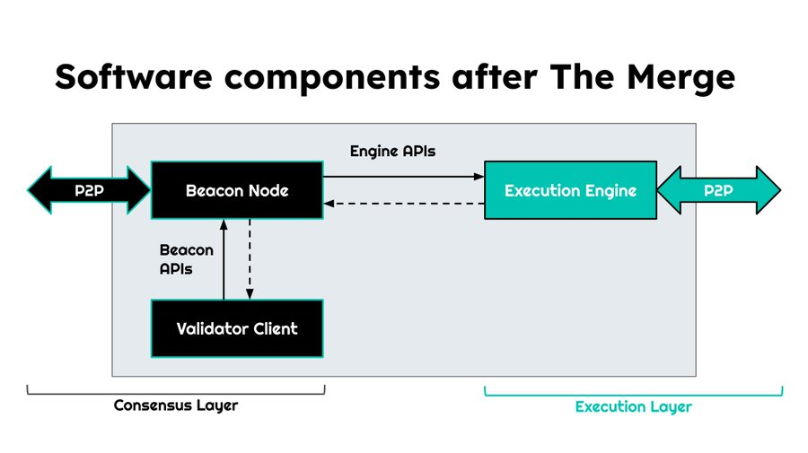
The Merge (6/6)
https://twitter.com/icebearhww/status/1641371721755398144

Slide 14
Proof-of-Stake (1/2)
https://ethereum.org/en/developers/docs/consensus-mechanisms/pos/
Proof-of-stake is a type of consensus mechanism used by blockchain networks to achieve distributed consensus.
Proof-of-stake is the underlying mechanism that activates validators upon receipt of enough stake. For Ethereum, users will need to stake 32 ETH to become a validator. Validators are chosen at random to create blocks and are responsible for checking and confirming blocks they don't create.
Unlike proof-of-work, validators don't need to use significant amounts of computational power because they're selected at random and aren't competing. They just need to create blocks when chosen and validate proposed blocks when they're not. This validation is known as attesting.

Slide 15
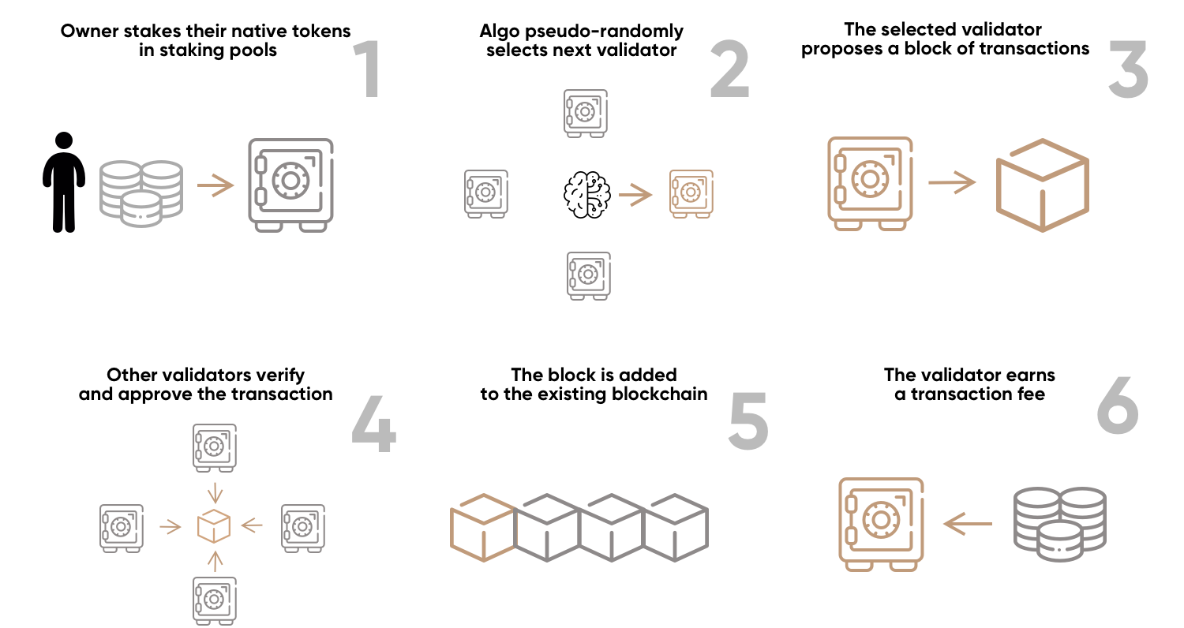
Proof-of-Stake (2/2)

Slide 16
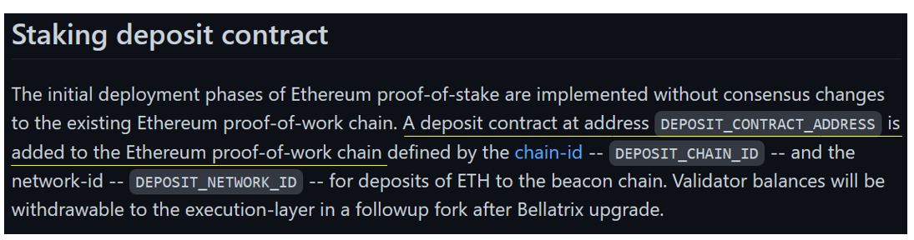
Ref. Ethereum 2.0 Staking (1/2)
https://github.com/ethereum/consensus-specs/blob/dev/specs/phase0/deposit-contract.md
You will not be able to withdraw staked assets for the duration of the lock-up period. With Ethereum (ETH), this period will last until the Ethereum 2.0 upgrade is fully completed. (Completed by the Shanghai upgrade on March 12, 2023)

Slide 17
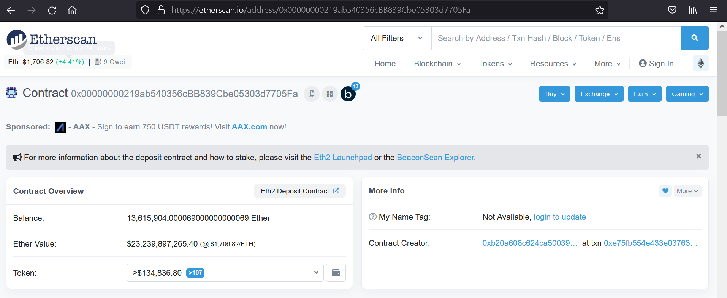
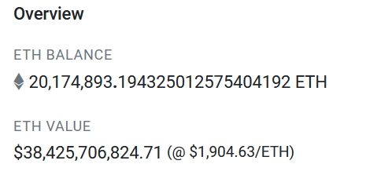
Ref. Ethereum 2.0 Staking (2/2)
Deposit Contract Information on Etherscan (As of 2022.9.9)
(As of 2023.5.5)
https://etherscan.io/address/0x00000000219ab540356cBB839Cbe05303d7705Fa

Slide 18
Danksharding (1/5)
https://ethereum.org/en/roadmap/danksharding/
Danksharding is how Ethereum becomes a truly scalable blockchain, but there are several protocol upgrades required to get there. Proto-Danksharding is an intermediate step along the way.
Both aim to make transactions on Layer 2 as cheap as possible for users and should scale Ethereum to >100,000 transactions per second.
Proto-Danksharding, also known as EIP-4844, is a way for rollups to add cheaper data to blocks.
The name comes from the two researchers who proposed the idea: Protolambda and Dankrad Feist.

Slide 19
Danksharding (2/5)
Rollups are limited in how cheap they can make user transactions by the fact that they post their transactions in CALLDATA. This is expensive because it is processed by all Ethereum nodes and lives on chain forever, even though rollups only need the data for a short time.
Proto-Danksharding introduces data blobs that can be sent and attached to blocks. The data in these blobs is not accessible to the EVM and is automatically deleted after a fixed time period (1-3 months). This means rollups can send their data much more cheaply and pass the savings on to end users in the form of cheaper transactions.
Why do blobs make rollup cheaper? Why it is OK to delete the blob data? --> Ref. the URL.

Slide 20
Danksharding (3/5)
Danksharding is the full realization of the rollup scaling that began with Proto-Danksharding.
Danksharding will bring massive amounts of space on Ethereum for rollups to dump their compressed transaction data.
This means Ethereum will be able to support hundreds of individual rollups with ease and make millions of transactions per second a reality.
The way this works is by expanding the blobs attached to blocks from 1 in Proto-Danksharding to 64 in full Danksharding.

Slide 21
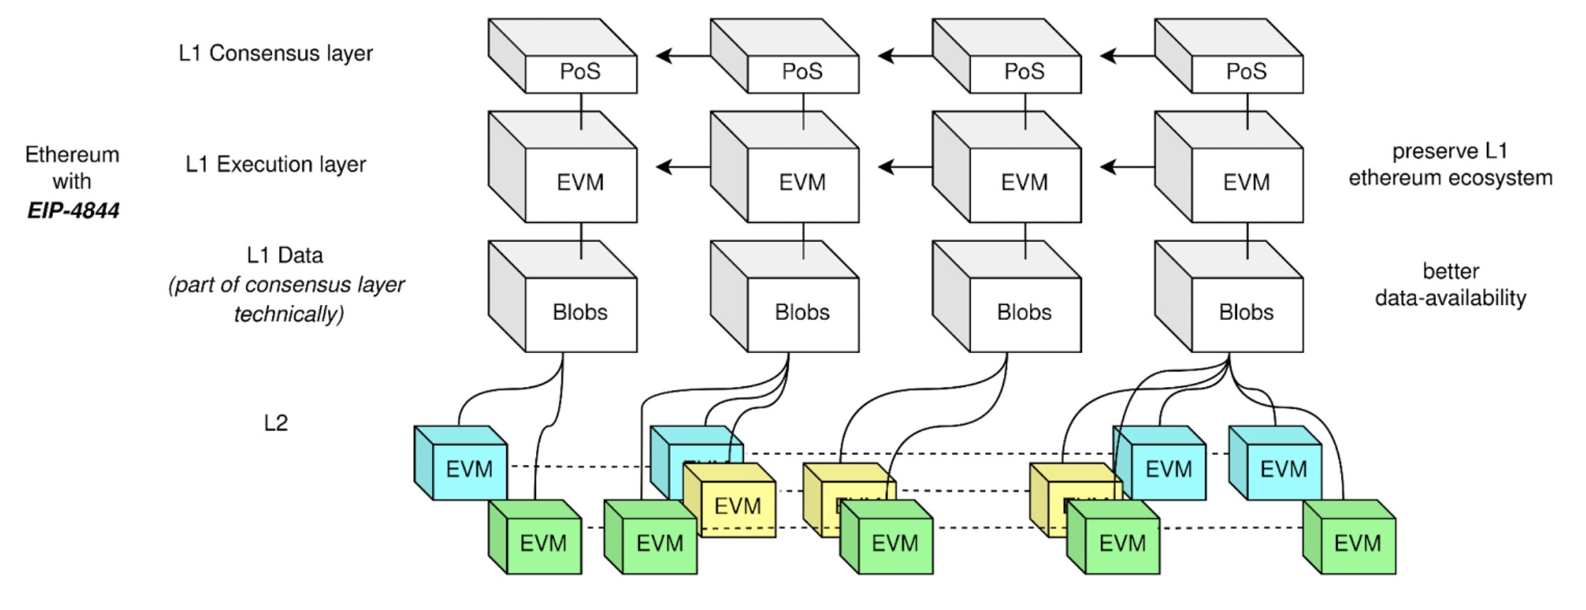
Danksharding (4/5)
https://hackmd.io/@luozhu/SyleCcpti

Slide 22
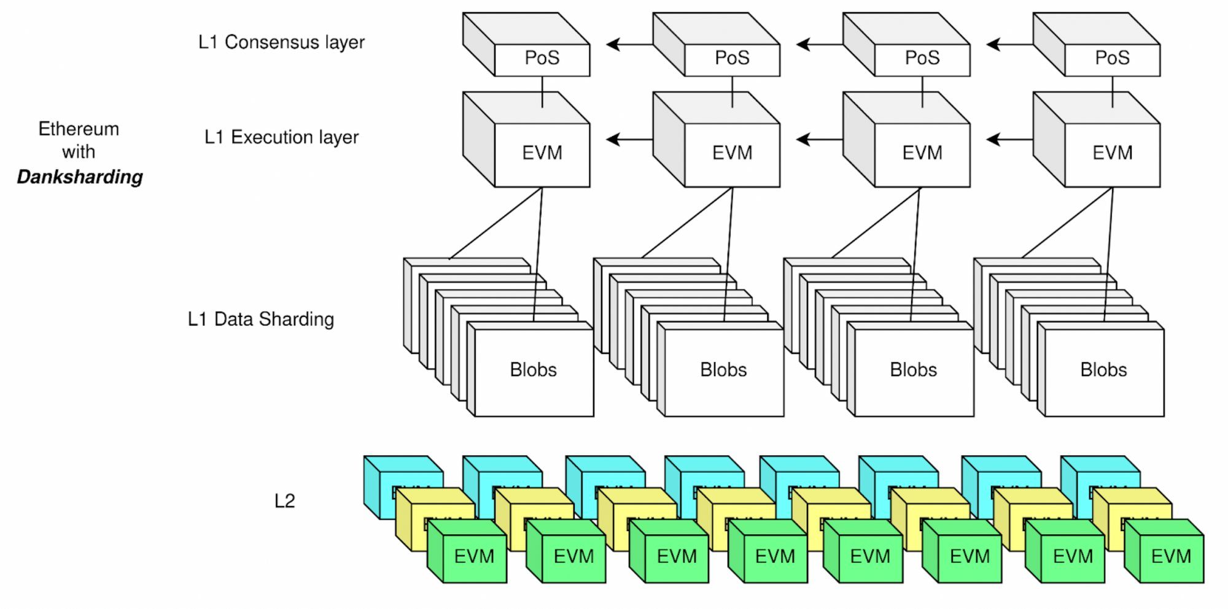
Danksharding (5/5)

Slide 23
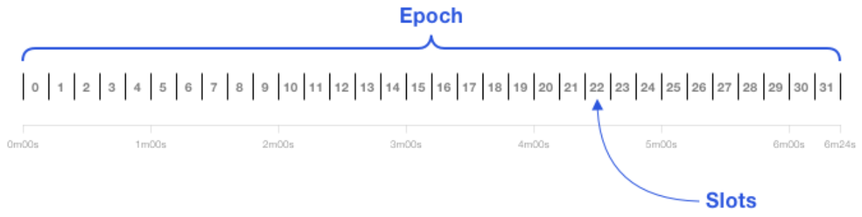
Ethereum Consensus Layer (1/8)
https://ethos.dev/beacon-chain/
Slots and Epochs
The Beacon Chain provides the heartbeat to Ethereum’s consensus. Each slot is 12 seconds and an epoch is 32 slots: 6.4 minutes.
A slot is a chance for a block to be added to the Beacon Chain. Every 12 seconds, one block is added when the system is running optimally. Validators do need to be roughly synchronized with time.
A slot is like the block time, but slots can be empty.
The first 32 slots are in Epoch 0. Genesis blocks are at Slot 0.

Slide 24
Ethereum Consensus Layer (2/8)
Validators and Attestations
While PoW is associated with miners, Ethereum’s validators are PoS “virtual miners”. Validators run Ethereum’s consensus.
A block proposer is a validator that has been pseudorandomly selected to build a block.
Most of the time, validators are attesters that vote on blocks. These votes are recorded in the Beacon Chain and determine the head of the Beacon Chain.
An attestation is a validator’s vote, weighted by the validator’s balance. Attestations are broadcasted by validators in addition to blocks.
At every epoch, a validator is pseudorandomly assigned to a slot.
The contents of the Beacon Chain is primarily a registry of validator addresses, the state of each validator, and attestations.

Slide 25
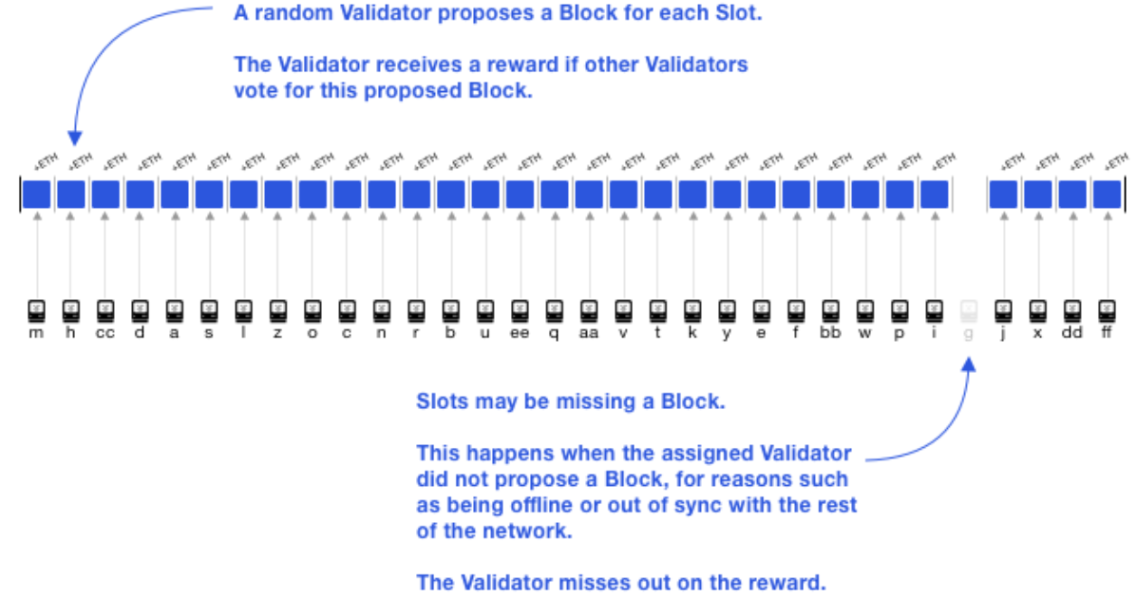
Ethereum Consensus Layer (3/8)
A missed proposal for some epoch's 28th slot.

Slide 26
Ethereum Consensus Layer (4/8)
Staking validators
Users stake ETH to activate and control validators.
It is clearer to associate stakers with a stake, and validators with a balance. Each validator has a maximum balance of 32 ETH, but stakers can stake all their ETH. For every 32 ETH staked, one validator is activated.
Committees
A committee is a group of validators. For security, each slot has committees of at least 128 validators. An attacker has less than a one in a trillion probability of controlling ⅔ of a committee.
The concept of a randomness beacon that emits random numbers for the public, lends its name to the Ethereum Beacon Chain. The Beacon Chain enforces consensus on a pseudorandom process called RANDAO.

Slide 27
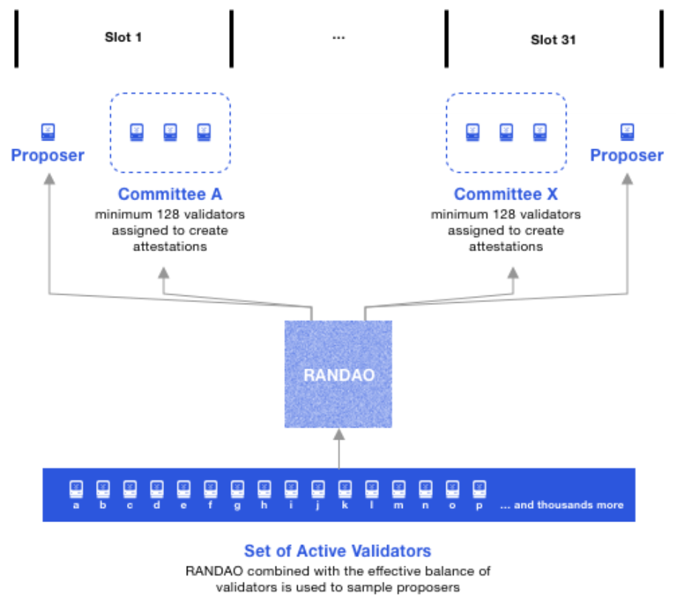
Ethereum Consensus Layer (5/8)
At every epoch, a pseudorandom process RANDAO selects proposers (with a weighting on the validator’s balance) for each slot, and shuffles validators to committees.
RANDAO mixes a hash from the block proposer with a seed that gets updated every block. This value is used to select a specific validator from the total validator set.

Slide 28
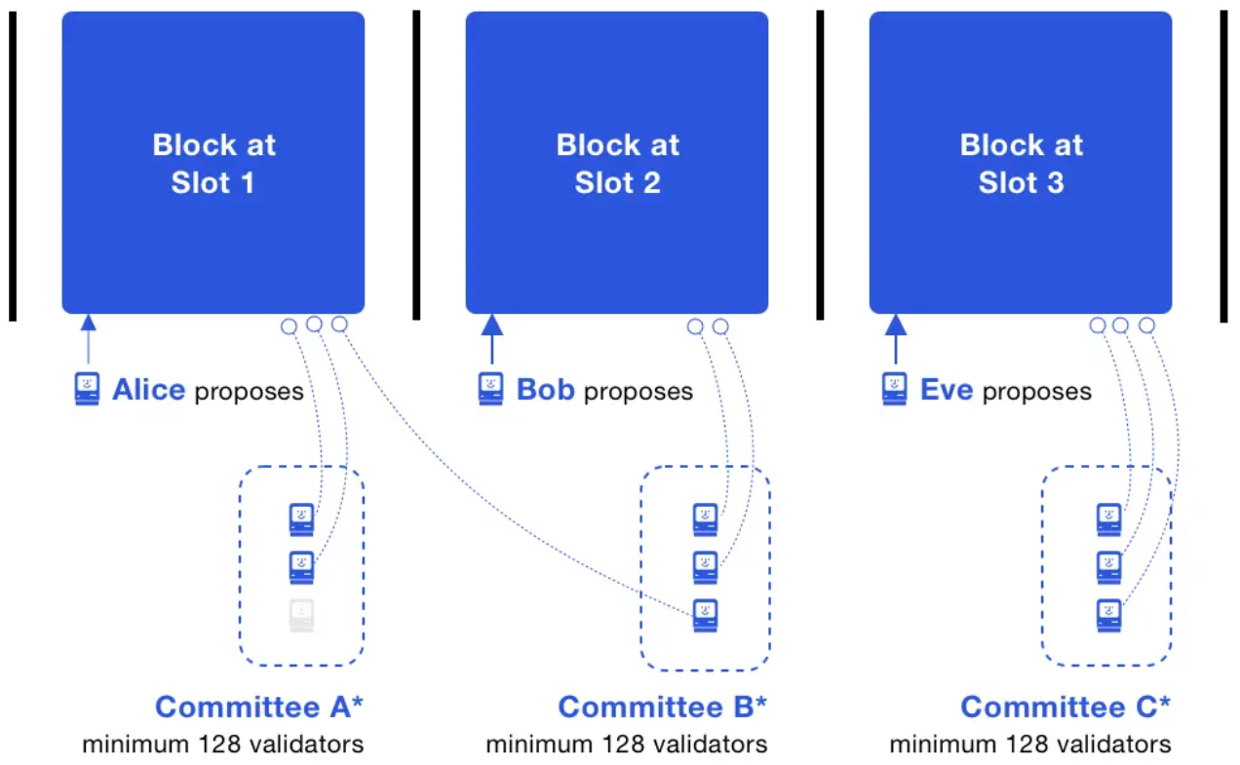
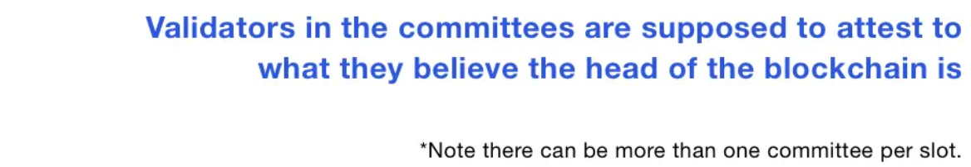
Ethereum Consensus Layer (6/8)
In Slot 1, a block is proposed and then attested to by two validators; one validator in Committee A was offline. The attestations and block at Slot 1 propagate the network and reach many validators.
In Slot 2, a block is proposed and a validator in Committee B does not see it, thus it attests that the Beacon Chain head is the block at Slot 1. Note this validator is different from the offline validator from Slot 1. Attesting to the Beacon Chain head is called an LMD GHOST vote.
In Slot 3, all validators in Committee C run the LMD GHOST fork choice rule, and independently attest to the same head.

Slide 29
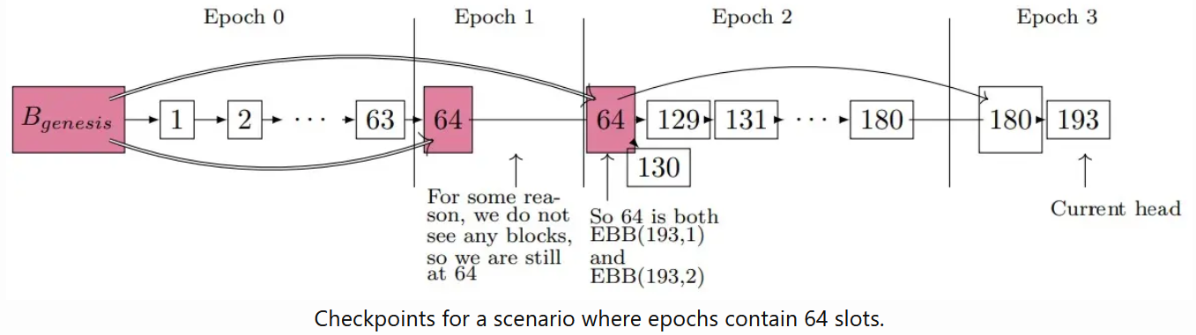
Ethereum Consensus Layer (7/8)
Beacon Chain Checkpoints
A checkpoint is a block in the first slot of an epoch. If there is no such block, then the checkpoint is the preceding most recent block. There is always one checkpoint block per epoch. A block can be the checkpoint for multiple epochs.

Slide 30
Ethereum Consensus Layer (8/8)
Supermajority
A vote that is made by ⅔ of the total balance of all active validators, is deemed a supermajority.
Finality
When an epoch ends, if its checkpoint has garnered a ⅔ supermajority, the checkpoint gets justified.
If a checkpoint B is justified and the checkpoint in the immediate next epoch becomes justified, then B becomes finalized. Typically, a checkpoint is finalized in two epochs, 12.8 minutes.
On average, a user transaction would be in a block in the middle of an epoch. It’s half an epoch until the next checkpoint, suggesting transaction finality of 2.5 epochs: 16 minutes.

Slide 31
Ethereum Scaling (1/3)
https://ethereum.org/en/developers/docs/scaling/
The main goal of scalability is to increase transaction speed (faster finality), and transaction throughput (high transactions per second), without sacrificing decentralization or security.
On-Chain scaling
This method of scaling requires changes to the Ethereum protocol (layer 1 Mainnet).
For a long time, sharding the blockchain was expected to scale Ethereum. This was going to involve splitting the blockchain into discrete pieces (shards) to be verified by subsets of validators. However, scaling by layer-2 rollups has taken over as the primary scaling technique.
Good Article: https://blog.coinbase.com/scaling-ethereum-crypto-for-a-billion-users-715ce15afc0b

Slide 32
Ethereum Scaling (2/3)
Sharding
Sharding is the process of splitting a database. Subsets of validators would be responsible for individual shards rather than keeping track of all of Ethereum.
Sharding was on the Ethereum roadmap for a long time. However, the rapid development of layer 2 rollups and the invention of Danksharding (adding blobs of rollup data to Ethereum blocks that can be very efficiently verified by validators) has led the Ethereum community to favour rollup-centric scaling instead of scaling by sharding.
Off-chain scaling
Off-chain solutions are implemented separately from layer 1 Mainnet - they require no changes to the existing Ethereum protocol.

Slide 33
Ethereum Scaling (3/3)
Off-chain scaling (cont.)
Off-chain solutions are implemented separately from layer 1 Mainnet - they require no changes to the existing Ethereum protocol.
Some solutions, known as "layer 2" solutions, derive their security directly from layer 1 Ethereum consensus, such as optimistic rollups, zero-knowledge rollups or state channels.
Other solutions involve the creation of new chains in various forms that derive their security separately from Mainnet, such as sidechains, validiums, or plasma chains. These solutions communicate with Mainnet, but derive their security differently to obtain a variety of goals.

Slide 34
Layer 2 Scaling
Layer 2 is a collective term for solutions designed to help scale your application by handling transactions off the Ethereum Mainnet (layer 1) while taking advantage of the robust decentralized security model of Mainnet.
Most layer 2 solutions are centered around a server or cluster of servers, each of which may be referred to as a node, validator, operator, sequencer, block producer, or similar term.
Generally speaking, transactions are submitted to these layer 2 nodes instead of being submitted directly to layer 1 (Mainnet). For some solutions the layer 2 instance then batches them into groups before anchoring them to layer 1, after which they are secured by layer 1 and cannot be altered.

Slide 35
Layer 2 Scaling: Rollups
Rollups
Rollups perform transaction execution outside layer 1 and then the data is posted to layer 1 where consensus is reached. As transaction data is included in layer 1 blocks, this allows rollups to be secured by native Ethereum security.
There are two types of rollups with different security models: Optimistic rollups, Zero-Knowledge rollups.
Optimistic rollups
Assumes transactions are valid by default and only runs computation, via a fraud proof, in the event of a challenge.
Zero-Knowledge rollups
Runs computation off-chain and submits a validity proof to the chain.

Slide 36
Ref. Optimistic rollups (1/4)
Optimistic rollup operators bundle multiple off-chain transactions together in large batches before submitting to Ethereum.
Optimistic rollups process transactions off the main Ethereum chain, but post off-chain transactions (in batches) to an on-chain rollup contract. Like the Ethereum blockchain, this transaction record is immutable and forms the "optimistic rollup chain."
Optimistic rollups are considered “optimistic” because they assume off-chain transactions are valid and don't publish proofs of validity for transaction batches posted on-chain.
This separates optimistic rollups from zero-knowledge rollups that publish cryptographic proofs of validity for off-chain transactions.

Slide 37
Ref. Optimistic rollups (2/4)
Optimistic rollups instead rely on a fraud-proving scheme to detect cases where transactions are not calculated correctly. After a rollup batch is submitted on Ethereum, there's a time window (called a challenge period) during which anyone can challenge the results of a rollup transaction by computing a fraud proof.
If the fraud proof succeeds, the rollup protocol re-executes the transaction(s) and updates the rollup's state accordingly. The other effect of a successful fraud proof is that the sequencer responsible for including the incorrectly executed transaction in a block receives a penalty.
If the rollup batch remains unchallenged (i.e., all transactions are correctly executed) after the challenge period elapses, it is deemed valid and accepted on Ethereum.

Slide 38
Ref. Optimistic rollups (3/4)
The architecture of an optimistic rollup comprises the following parts: On-chain contracts, Off-chain virtual machine (VM).
Users submit transactions to “operators” (also known as “validators” or “aggregators”), which are nodes responsible for processing transactions on the optimistic rollup. The operator aggregates transactions, compresses the underlying data, and publishes the block on Ethereum as calldata.
L1/L2 interoperability
To use an optimistic rollup, users deposit ETH, ERC-20 tokens, and other accepted assets in the rollup’s bridge contract on L1. The bridge contract will relay the transaction to L2, where an equivalent amount of assets is minted and sent to the user’s chosen address on the optimistic rollup.

Slide 39
Ref. Optimistic rollups (4/4)
Withdrawing from an optimistic rollup to Ethereum is more difficult owing to the fraud proving scheme. If a user initiates an L2 -> L1 transaction to withdraw funds escrowed on L1, they must wait until the challenge period—lasting roughly seven days—elapses.
To avoid waiting a week before withdrawing funds to Ethereum, optimistic rollup users can employ a liquidity provider (LP). A liquidity provider assumes ownership of a pending L2 withdrawal and pays the user on L1 (in exchange for a fee).
Ethereum Virtual Machine (EVM) compatibility
The advantage of optimistic rollups is their compatibility with the EVM. Developers can migrate existing smart contracts on Ethereum to optimistic rollup chains without having to modify codebases extensively.

Slide 40
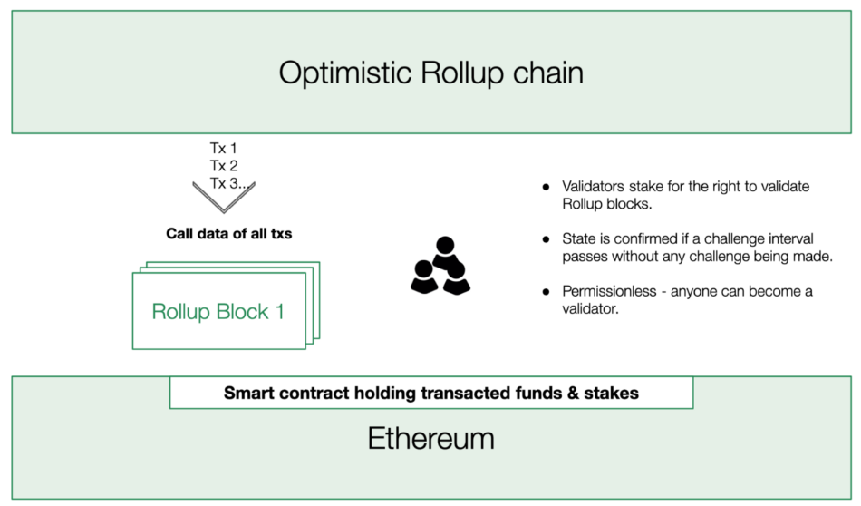
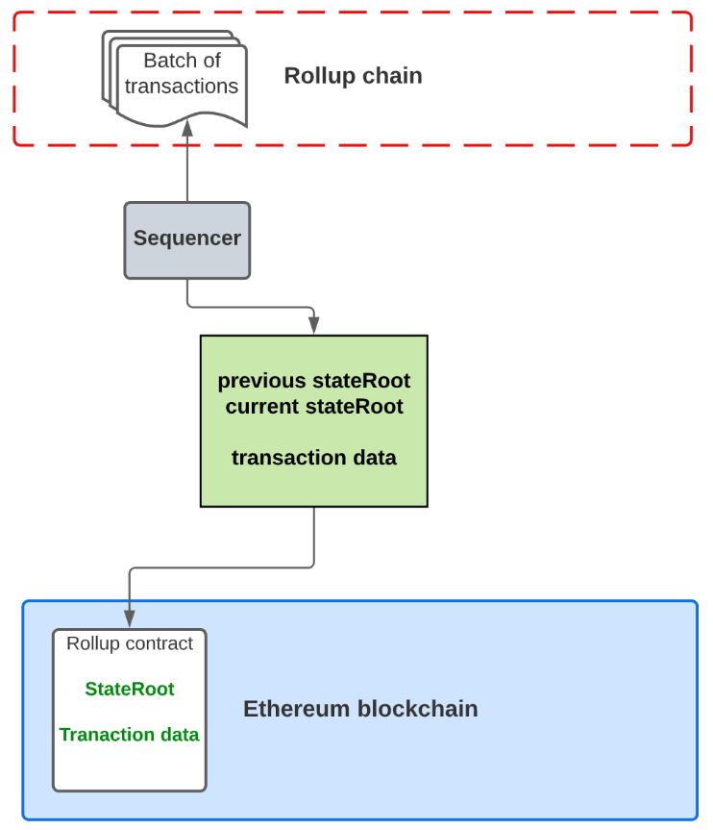
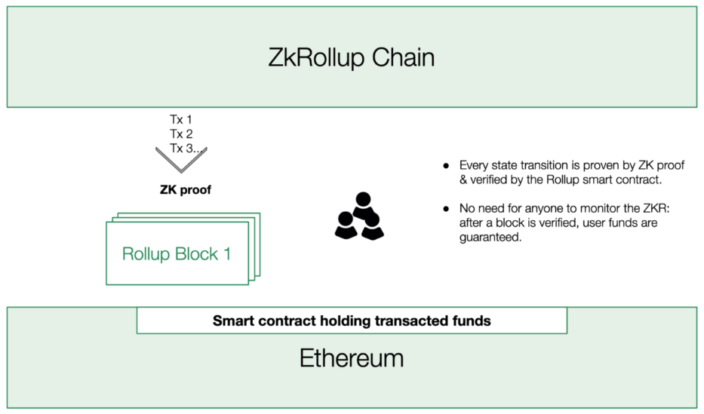
Ref. Rollups
https://medium.com/token-terminal/a-primer-on-ethereum-l2-scaling-techniques-17ac437891b1
Notes:
Rollups are very similar to Plasma in that we’re batching transactions off-chain and posting an update to the main blockchain. The key difference, however, is that with rollups, we also post the transaction data of each batch of transactions on-chain. With Plasma, we’re only posting the Merkle roots. Rollups also use a lot of fancy compression tricks to minimize the transaction data we post on-chain, so there’s much less data storage on-chain than there would be otherwise. There’s a “rollup contract” on the mainchain that maintains the current state of the rollup layer. This includes account balances of the users transacting on it and smart contract code of the contracts that live in it. In brief, the rollup contract keeps track of the “state root” of the transactions in the rollup layer.

Slide 41
Layer 2 Scaling: State Channels (1/2)
State channels allow participants to securely transact off-chain while keeping interaction with Ethereum Mainnet at a minimum.
Channel peers can conduct an arbitrary number of off-chain transactions while only submitting two on-chain transactions to open and close the channel. P2P channels are particularly useful for predefined participants to transact with high frequency without incurring visible overhead.
Each channel is managed by a multisig smart contract running on Ethereum. To open a channel, participants deploy the channel contract on-chain and deposit funds into it. Both parties collectively sign a state update to initialize the channel's state, after which they can transact quickly and freely off-chain.
To close the channel, participants submit the last agreed-upon state of the channel on-chain. Afterward, the smart contract distributes the locked funds according to each participant's balance in the channel's final state.

Slide 42
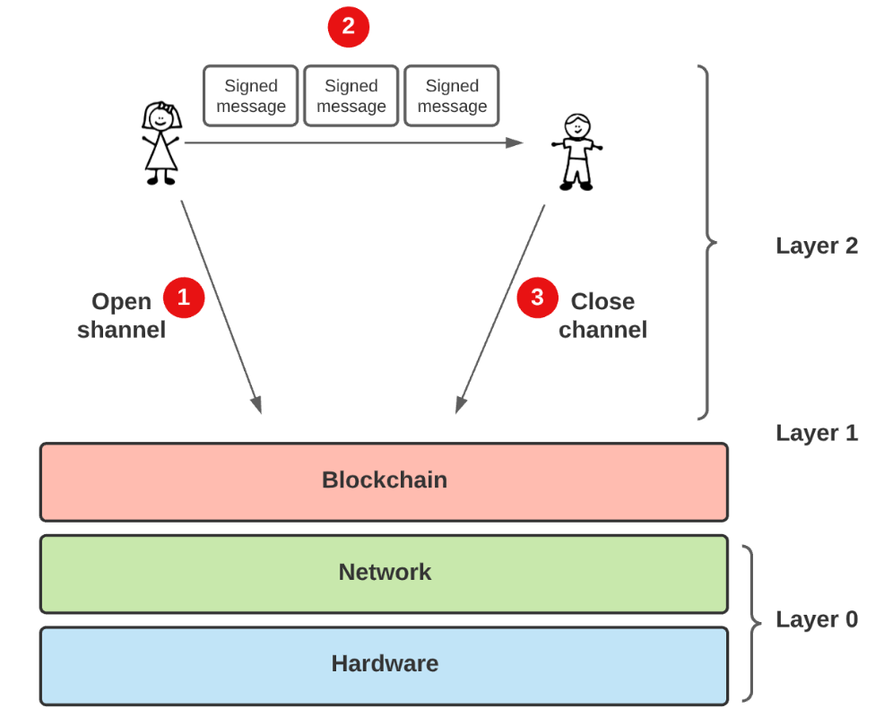
Layer 2 Scaling: State Channels (2/2)
https://www.preethikasireddy.com/post/a-normies-guide-to-rollups

Slide 43
Sidechains (1/2)
A sidechain is a separate blockchain that runs independent of Ethereum and is connected to Ethereum Mainnet by a two-way bridge.
Sidechains can have separate block parameters and consensus algorithms, which are often designed for efficient processing of transactions.
Using a sidechain involves trade-offs, though, as they do not inherit Ethereum's security properties. Unlike layer 2 scaling solutions, sidechains do not post state changes and transaction data back to Ethereum Mainnet.
Sidechains also sacrifice some measure of decentralization or security to achieve high throughput.

Slide 44
Sidechains (2/2)
Asset movement
In order for a separate blockchain to become a sidechain to Ethereum Mainnet it needs the ability to facilitate the transfer of assets from and to Ethereum Mainnet. This interoperability with Ethereum is achieved using a blockchain bridge. Bridges use smart contracts deployed on Ethereum Mainnet and a sidechain to control the bridging of funds between them.
While bridges help users move funds between Ethereum and the sidechain, the assets are not physically moved across the two chains. Instead, mechanisms that typically involve minting and burning are used for transferring value across chains.
Multiple projects provide implementations of sidechains:
Polygon PoS, Skale, Gnosis Chain, Loom Network, Metis Andromeda

Slide 45
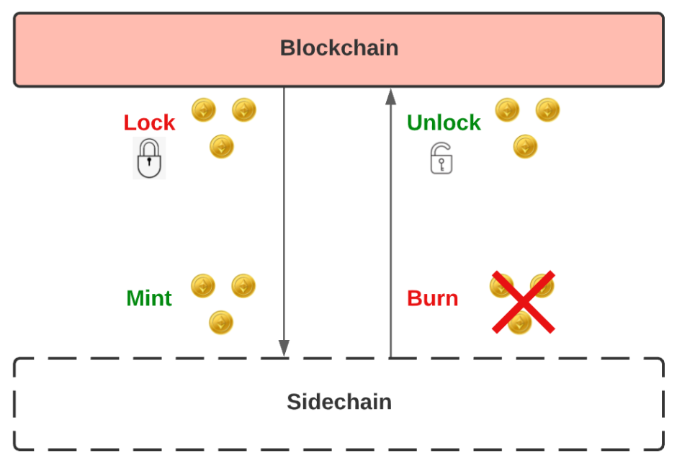
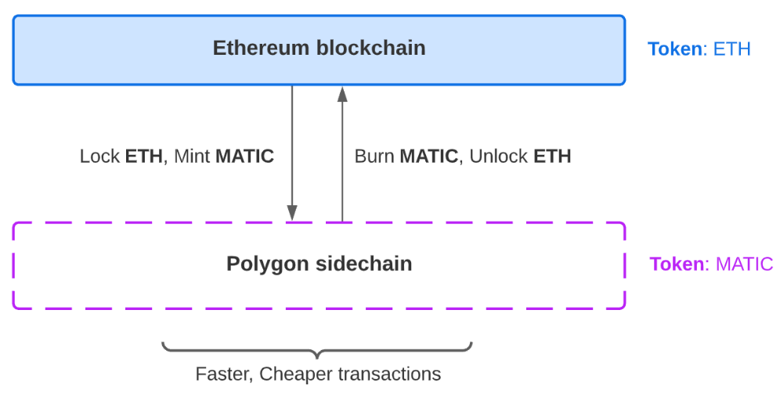
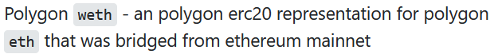
Ref. Sidechains
https://www.preethikasireddy.com/post/a-normies-guide-to-rollups
(Two-way peg)
(Polygon is a sidechain pegged to Ethereum)
On Ethereum, 1 ETH is 10¹⁸ Wei. On Polygon, 10¹⁸ Wei is 1 MATIC.
This is a huge difference considering the difference in the price of ETH and MATIC.
Notes:
How to move tokens from Ethereum to Polygon(Matic) using the official Polygon Bridge (Video): https://www.youtube.com/watch?v=WIqrNt4luQY
A sidechain is when we create a new blockchain that’s two-way pegged to the main blockchain. When we want faster transactions, we can move our funds from the mainchain to the sidechain and transact there. When we’re done, we move our funds back to the mainchain. An example of a sidechain for Bitcoin is the Liquid Network. The Liquid Network is pegged to Bitcoin and permits faster and cheaper Bitcoin payments. Another popular example is Polygon, which is a sidechain pegged to Ethereum. Note: Technically Matic is not a sidechain because it periodically commits the sidechain’s state to Ethereum. Hence, they like to call themselves a “commit chain.”

Slide 46
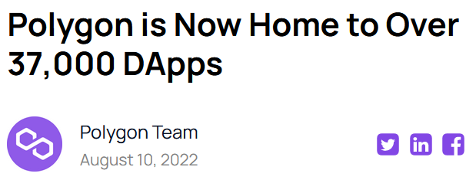
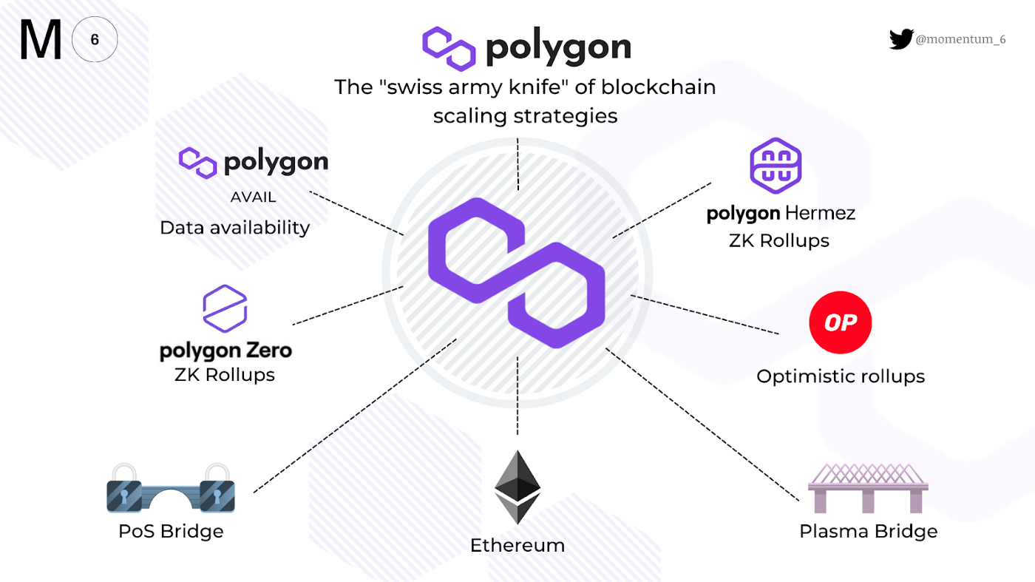
Ref. Polygon Framework
Notes:
Developing for Polygon and Sidechains: https://dev.to/rounakbanik/developing-for-polygon-and-sidechains-4h6a

Slide 47
Plasma and Validium
Plasma
Plasma chains are built atop another blockchain (called a "root chain"). Each "child chain" extends from the root chain and is generally managed by a smart contract deployed on the parent chain.
The Plasma contract functions, as a bridge allowing users to move assets between Ethereum Mainnet and the plasma chain. Plasma chains benefit—at least, to some extent—from Ethereum Mainnet's security. This is unlike sidechains that are solely responsible for their security.
Validium
Validium enforces integrity of transactions using validity proofs like ZK-rollups, but doesn’t store transaction data on the Ethereum Mainnet.

Slide 48
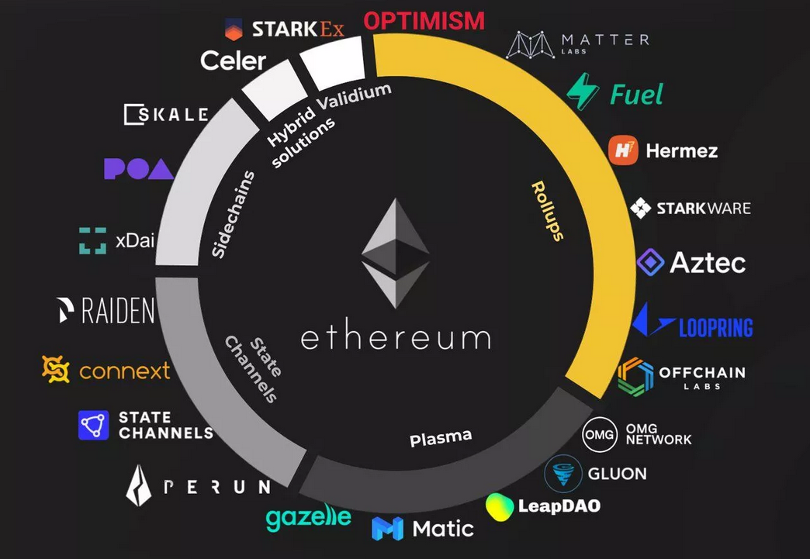


Ref. Ethereum Layer 2 Scaling Solutions

Slide 49
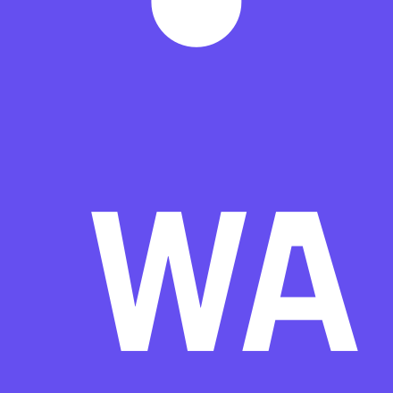
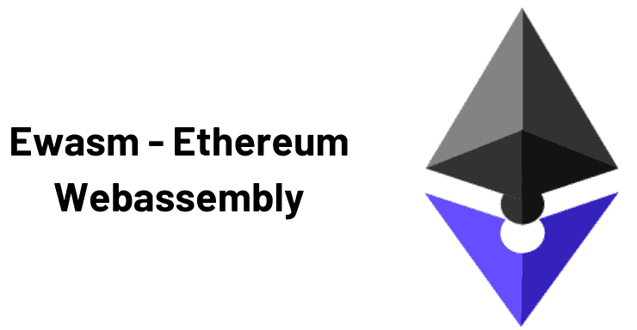
Ethereum WebAssembly (eWASM)
Ethereum WebAssembly is a proposed redesign of the Ethereum smart contract execution layer using a deterministic subset of WebAssembly (Wasm).
Wasm is a new, portable, size- and load-time-efficient format, currently being designed as an open standard by a W3C Community Group.
Wasm aims to execute at native speed by taking advantage of common hardware capabilities available on a wide range of platforms.
Major browser JavaScript engines will notably have native support for Wasm, including but not limited to: Google's V8 engine (Node.js and Chromium-based browsers), Microsoft's Chakra engine (Microsoft Edge), Mozilla's Spidermonkey engine (Firefox and Thunderbird).
https://ewasm.readthedocs.io/en/mkdocs/

Slide 50
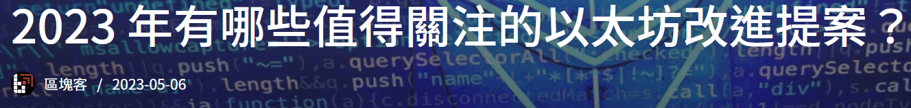
Ref. ERC-4337, ERC-6551, ERC-5507, EIP-4844
https://blockcast.it/2023/05/06/ethereum-improvement-proposalsto-look-forward-in-2023/
ERC-4337 aims to upgrade the EOA account used by users to a “smart account”, enabling the account to be executed as a smart contract.
The idea behind ERC-6551 is to link NFTs (ERC-721) and smart accounts into Token Binding Accounts (TBAs), it’s built on top of the ERC-4337 standard.
ERC-5507 aims to add a refund function for fungible and non-fungible tokens (ERC-20, ERC-721 and ERC-1155): before a preset time has elapsed, users have the right to refund their purchases Token.
EIP-4844: Proto-Danksharding. It is a step before Ethereum DankSharding

